Slide 1
JOINS IN SQL SERVER

Slide 2


LEARNING GOALS
By the end of this lecture students should be able to:
Understand about SQL joins in SQL Server
Using smoothly SQL joins and apply to project

Slide 3

Lesson Agenda
What’s SQL Join?
Inner Join
Outer Join
Cross Join
Self Join
Excluding JOIN

Slide 4

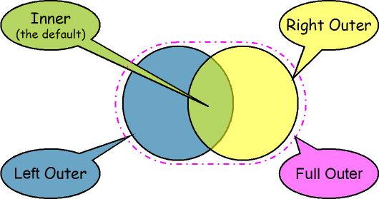
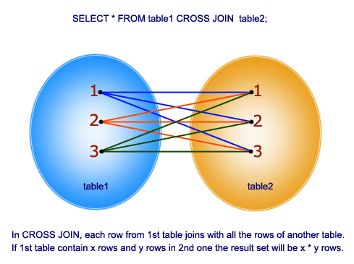
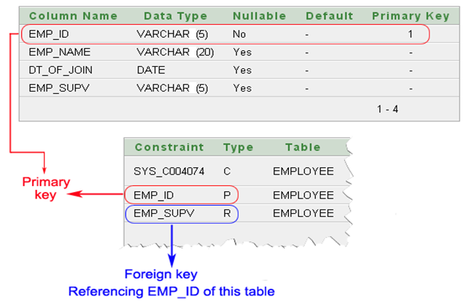
Options ?
SQL Joins are used to combine rows from two or more tables based on logical relationships between the tables.
Types of Join in SQL:
Inner Join
Outer Join
Cross Join
Self Join
Notes:
4

Slide 5
INNER JOIN
Section 1

Slide 6
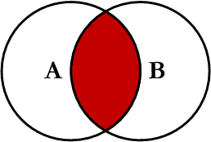
INNER JOIN
The INNER JOIN selects all rows from both tables as long as there is a match between the columns in both tables.
Eliminate the rows that do not match with a row from the other table
Syntax
SELECT col_names
FROM Table_A A
INNER JOIN Table_B B
ON A.Col1 = B.Col1
Notes:
4

Slide 7
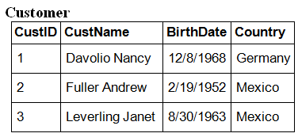
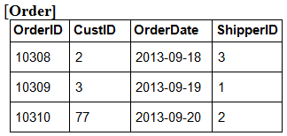

INNER JOIN (2/2)
Example:
SELECT c.CustName, o.OrderID
FROM Customer c
INNER JOIN [Order] o
ON c.CustID = o.CustID
ORDER BY c.CustName;
Result:
Notes:
4

Slide 8
OUTER JOIN
Section 2

Slide 9
OUTER JOIN
Outer Join: Return all rows from at least one of the tables mentioned in the FROM clause, as long as those rows meet any WHERE or HAVING search conditions:
LEFT OUTER JOIN (or LEFT JOIN)
RIGHT OUTER JOIN (or RIGHT JOIN)
FULL OUTER JOIN (or FULL JOIN)
Notes:
4
http://www.codeproject.com/Articles/33052/Visual-Representation-of-SQL-Joins

Slide 10
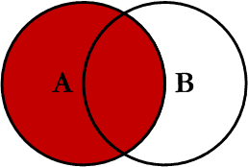
LEFT OUTER JOIN
Return all of the records in the left table (table A) regardless if any of those records has a match in the right table (table B)
In the results where there is no matching condition, the row contains NULL values for the right table’s columns.
Syntax
SELECT col_names
FROM Table_A A LEFT JOIN Table_B B
ON A.Col1 = B.Col1
Notes:
4

Slide 11
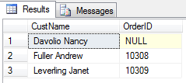
LEFT OUTER JOIN
Example:
SELECT c.CustName, o.OrderID
FROM Customer c LEFT JOIN [Order] o
ON c.CustID = o.CustID
ORDER BY c.CustName;
Result:
Notes:
4

Slide 12
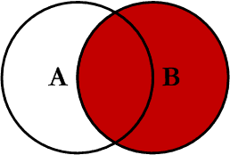
RIGHT OUTER JOIN
Return all of the records in the right table (table B) regardless if any of those records have a match in the left table (table A)
In the results where there is no matching condition, the row contains NULL values for the left table’s columns.
Syntax
SELECT col_names
FROM Table_A A RIGHT JOIN Table_B B
ON A.Col1 = B.Col1
Notes:
4

Slide 13
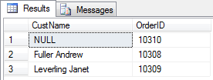
RIGHT OUTER JOIN
Example:
SELECT c.CustName, o.OrderID
FROM Customer c RIGHT JOIN [Order] o
ON c.CustID = o.CustID
ORDER BY c.CustName;
Result:
Notes:
4

Slide 14
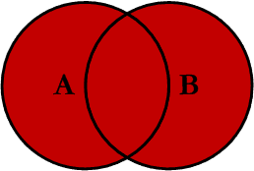
FULL OUTER JOIN
Return all of the records from both tables, joining records from the left table (table A) that match records from the right table (table B)
Syntax
SELECT col_names
FROM Table_A A FULL JOIN Table_B B
ON A.Col1 = B.Col1
Notes:
4

Slide 15
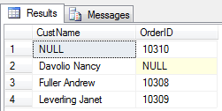
FULL OUTER JOIN (2/2)
Example:
SELECT c.CustName, o.OrderID
FROM Customer c FULL JOIN [Order] o
ON c.CustID = o.CustID
ORDER BY c.CustName;
Result:
Notes:
4

Slide 16
CROSS JOIN
Section 3

Slide 17
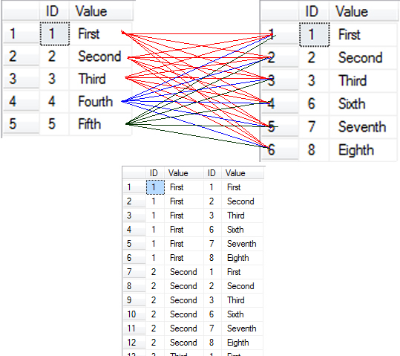
CROSS JOIN
Return records that are multiplication of record number from both the tables
No need any condition to join
Syntax
SELECT col_names
FROM Table_A A CROSS JOIN Table_B B
Notes:
4

Slide 18
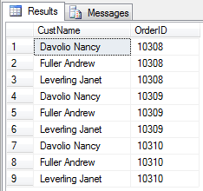
CROSS JOIN
Example:
SELECT c.CustName, o.OrderID
FROM Customer c CROSS JOIN [Order] o
Result:
Notes:
4

Slide 19
Self JOIN
Section 4

Slide 20
Self JOIN
A SELF JOIN is a join of a table to itself. In SELF JOIN, we can use:
INNER JOIN
OUTER JOIN
CROSS JOIN
Notes:
4

Slide 21
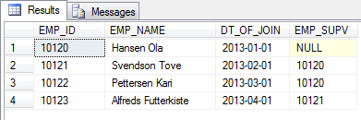
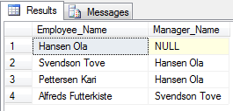
Self JOIN
Example:
SELECT e1.EMP_NAME AS Employee_Name,
e2.EMP_NAME AS Manager_Name
FROM Employee e1 LEFT JOIN Employee e2
ON e1.EMP_SUPV = e2.EMP_ID
Result:
Notes:
4

Slide 22
Excluding JOIN
Section 5

Slide 23
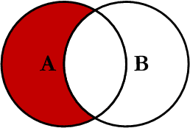
LEFT Excluding JOIN
Return all of the records in the left table (table A) that do not match any records in the right table (table B)
Syntax
SELECT col_names
FROM Table_A A LEFT JOIN Table_B B
ON A.Col1 = B.Col1
WHERE B.Col1 IS NULL
Notes:
4

Slide 24
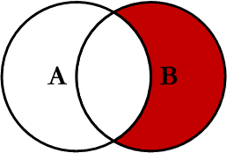
RIGHT Excluding JOIN
Returns records in the right table (table B) that do not match any records in the left table (table A)
In the results where there is no matching condition, the row contains NULL values for the right table’s columns.
Syntax
SELECT col_names
FROM Table_A A RIGHT JOIN Table_B B
ON A.Col1 = B.Col1
WHERE A.Col1 IS NULL
Notes:
4

Slide 25
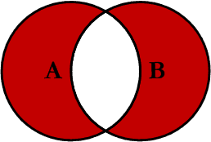
OUTER JOIN EXCLUDING JOIN
Return all of the records in the left table (table A) and all of the records in the right table (table B) that do not match
Syntax
SELECT col_names
FROM Table_A A
FULL OUTER JOIN Table_B B
ON A.Col1 = B.Col1
WHERE A.Col1 IS NULL OR B.Col1 IS NULL
Notes:
4

Slide 26
Joining Three or More Tables
Since FROM clauses can contain multiple join specifications, this allows many tables to be joined for a single query.
Syntax
SELECT col_names
FROM Table_A A JOIN Table_B B
ON A.Col1 = B.Col1 LEFT JOIN Table_C C
ON B.Col2 = C.Col2
….
Notes:
4

Slide 27
SUMMARY

Slide 28

Q&A Thank you
28

